Slide 1
ECE 4115
Control Systems Lab 1
Spring 2005
Chapter 2
Time Response of Systems
Prepared by: Nisarg Mehta

Slide 2
Matlab
Start → Run → \\laser\apps
Open MatlabR14 and double click on MATLAB 7.0.1

Slide 3
Previous Class
4 basic types of LTI models
  Transfer Function: tf, tfdata
  Zero-pole-gain model: zpk, zpkdata
  State-Space models: ss, ssdata
  Frequency response data: frd
Conversion between models
Model dynamics: pzmap, pole, eig, zero, dcgain

Slide 4
TIME RESPONSE OF SYSTEMS
Once a model of a system has been defined, we might be interested in knowing the time response of such system to a certain input.
The Control Systems Toolbox of MATLAB provides several commands to perform this task.

Slide 5
Objectives
Impulse Response (impulse)
Step Response (step)
General Time Response (lsim)
Polynomial multiplication (conv)
Polynomial division (deconv)
Partial Fraction Expansion (residue)

Slide 6
Impulse Response
The impulse response of a system is its output when the input is a unit impulse.

Slide 7
Impulse Response
Command | Help
impulse | Impulse response of LTI models. impulse(sys) plots the impulse response of the LTI model sys (created with either tf, zpk, or ss). The time range and number of points are chosen automatically. impulse(sys,tfinal) simulates the impulse response from t=0 to the final time t=tfinal. impulse(sys,t) uses the user-supplied time vector t for simulation.

Slide 8
Impulse Response
Command | Help
impulse (cont’d) | When invoked with left-hand arguments, [y,t]=impulse(sys) returns the output response y and the time vector t used for simulation. No plot is drawn on the screen. For state-space models, [y,t,x]=impulse(sys,...) also returns the state trajectory x.

Slide 9
Step Response
The step response of a system is its output when the input is a unit step.

Slide 10
Step Response
Command | Help
step | Step response of LTI models. step(sys) plots the step response of the LTI model sys (created with either tf, zpk, or ss). The time range and number of points are chosen automatically. step(sys,tfinal) simulates the step response from t=0 to the final time t=tfinal. step(sys,t) uses the user-supplied time vector t for simulation.

Slide 11
Step Response
Command | Help
step (cont’d) | When invoked with left-hand arguments, [y,t]=step(sys) returns the output response y and the time vector t used for simulation. No plot is drawn on the screen. For state-space models, [y,t,x]=step(sys,...) also returns the state trajectory x.

Slide 12
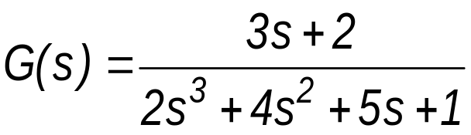

Problem 1
  Problem 1: Given the LTI system
  Plot the following responses for
  a) The impulse response using the impulse command.
  b) The step response using the step command.
  c) The response to the input calculated using both the lsim and the residue commands

Slide 13
H:\ECE4115\Chp2\Chp2_1.m
  clear all
  close all
  clc
  A=[3 2];
  B=[2 4 5 1];
  sys=tf(A,B);
  t=0:0.01:10;
  impulse(sys,t); %Impulse Response
  figure;
  Step(sys,t); %Step Response

Slide 14
Response to a general input
The general response of a system to any input can be computed using the lsim command.

Slide 15
Response to a general input
Command | Help
lsim | Simulate time response of LTI models to arbitrary inputs. lsim(sys,u,t) plots the time response of the LTI model sys to the input signal described by u and t. The time vector t consists of regularly spaced time samples and u is a vector whose i-th entry specifies the input value at time t(i). lsim(sys,u,t,x0) specifies the initial state vector x0 at time t(1) (for state-space models only); x0 is set to zero when omitted.

Slide 16
Response to a general input
Command | Help
lsim (cont’d) | y=lsim(sys,u,t) returns the output history Y. No plot is drawn on the screen. For state-space models, [y,t,x]=lsim(sys,u,t,x0) also returns the state trajectory x, a matrix with as many columns as states.

Slide 17
Problem 1
  Problem 1: Given the LTI system
  Plot the following responses for
  a) The impulse response using the impulse command.
  b) The step response using the step command.
  c) The response to the input calculated using both the lsim and the residue commands

Slide 18
H:\ECE4115\Chp2\Chp2_1.m
  clear all
  close all
  clc
  A=[3 2];
  B=[2 4 5 1];
  sys=tf(A,B);
  t=0:0.01:10;
  %Impulse response
  impulse(sys,t);

Slide 19
H:\ECE4115\Chp2\Chp2_1.m
  %Step response
  figure
  step(sys,t);
  %Response to a sinusoidal input
  u=sin(0.5*t);
  figure
  lsim(sys,u,t);

Slide 20
Commands conv and deconv
conv | Convolution and polynomial multiplication. C=conv(A,B) convolves vectors A and B. If A and B are vectors of polynomial coefficients, convolving them is equivalent to multiplying the two polynomials.
deconv | Deconvolution and polynomial division. [Q,R]=deconv(B,A) deconvolves vector A out of vector B. If A and B are vectors of polynomial coefficients, deconvolution is equivalent to polynomial division. The result of dividing B by A is quotient Q and remainder R, such that B=conv(A,Q)+R

Slide 21
Polynomial Multiplication
  The polynomial product:
  can be solved in MATLAB by typing
  C=conv([1 3 -1],[2 -4 3])
  and the following output will be obtained
  C =
    2 2 -11 13 -3

Slide 22
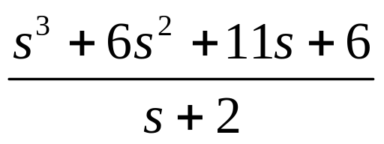
Polynomial Division
  The polynomial division:
  can be computed in MATLAB by entering [Q,R]=deconv([1 6 11 6],[1 2]) and the output is
    Q =
    1 4 3
    R =
    0 0 0 0

Slide 23
Command Residue
Command | Help
residue | Partial-fraction expansion (residues). [r,p,k]=residue(A,B) finds the residues, poles and direct term of a partial fraction expansion of the ratio of two polynomials B(s)/A(s).

Slide 24
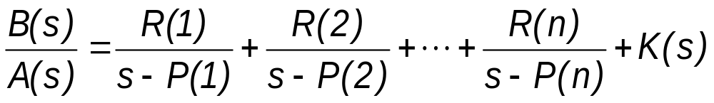
Command Residue
residue (cont’d) | If there are no multiple roots Vectors B and A specify the coefficients of the numerator and denominator polynomials in descending powers of s. The residues are returned in the column vector r, the pole locations in column vector p, and the direct terms in row vector k. The number of poles is n=length(A)-1=length(R)=length(P). The direct term coefficient vector is empty if length(B)<length(A), otherwise length(K)=length(B)-length(A)+1.

Slide 25
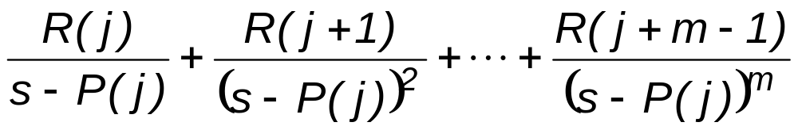
Command Residue
residue (cont’d) | If P(j)= ... =P(j+m-1) is a pole of multiplicity m, then the expansion includes terms of the form [b,a]=residue(r,p,k), with 3 input arguments and 2 output arguments, converts the partial fraction expansion back to the polynomials with coefficients in b and a.

Slide 26
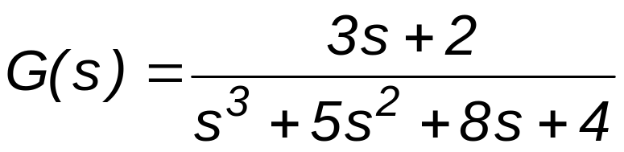
Problem 2
  Problem 2: Given the LTI system
  Find the step response using the residue command. Plot such response for

Slide 27
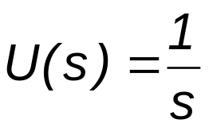
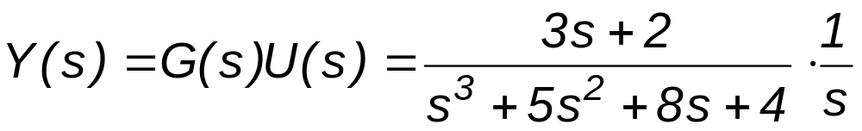
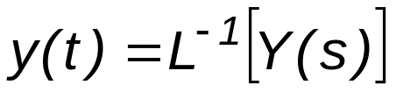
Problem 2: Solution
  Recall that
  To determine the Inverse Laplace Transform of a rational function, a partial fraction expansion is performed first, then each fraction is inverted and the individual inverse transforms are added up.

Slide 28
H:\ECE4115\Chp2\Chp2_2.m
  clear all
  close all
  clc
  A=[3 2];
  B=[1 5 8 4];
  Bu=conv(B,[1 0]);
  [r,p,k]=residue(A,Bu)

Slide 29
Chp2_2.m: Solution
    r =
    -1.50000000000000
    -2.00000000000000
    1.00000000000000
    0.50000000000000
    p =
    -2.00000000000000
    -2.00000000000000
    -1.00000000000000
    0
    k =
    []

Slide 30
Problem 3
  After the partial fraction expansion has been determined, it can be seen that:
    Y(s) has four poles, stored in vector p.
    One of them is a repeated pole
  Then, y(t) is given by:

Slide 31
H:\ECE4115\Chp2\Chp2_3.m
  clear all
  close all
  clc
  A=[3 2];
  B=[1 5 8 4];
  sys=tf(A,B);
  t=0:0.01:10;
  %Step response
  [ystep,t]=step(sys,t);

Slide 32
H:\ECE4115\Chp2\Chp2_3.m
  %Step response via the Inverse Laplace Transform
  Bu = conv(B,[1,0]);
  [r,p] = residue(A,Bu);
  ystep_res=r(1)*exp(p(1)*t)+r(2)*t.*exp(p(2)*t)
  +r(3)*exp(p(3)*t)+r(4)*exp(p(4)*t);
  %Figures
  subplot(2,1,1),plot(t,ystep_res,'k')
  xlabel('t')
  ylabel('y')
  subplot(2,1,2),plot(t,ystep,'k:')
  xlabel('t')
  ylabel('y')

Slide 33
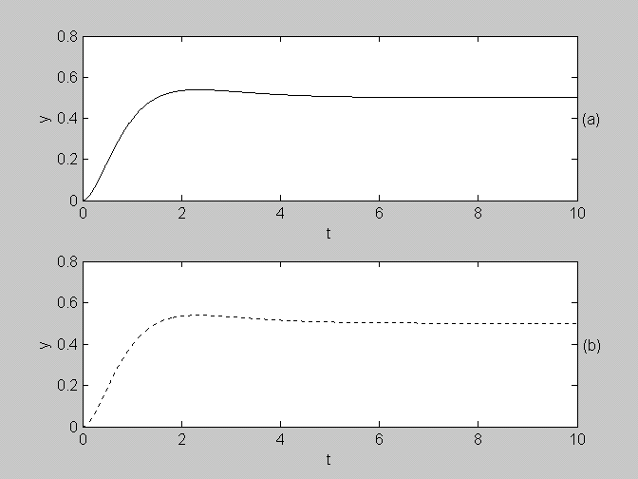
Figures
  The following Figure shows the step response using the Inverse Laplace Transform (a) and the step command (b)

Slide 34
Summary
Impulse response: Impulse
Step response: Step
General time response: lsim
Polynomial multiplication: conv
Polynomial division: deconv
Partial fraction expansion: residue

Slide 35
Homework #2
H:\ECE4115\Chp2\HW2_1.m
H:\ECE4115\Chp2\HW2_2.m
H:\ECE4115\Chp2\HW2_3.m

Slide 36
Questions???
Next Class: March 25th,2005

